Slide 1
Energy Resources

Slide 2
What Major Sources of Energy Do We Use?
About three-quarters of the world’s commercial energy comes from nonrenewable fossil fuels, and the rest comes from nonrenewable nuclear fuel and renewable sources.

Slide 3
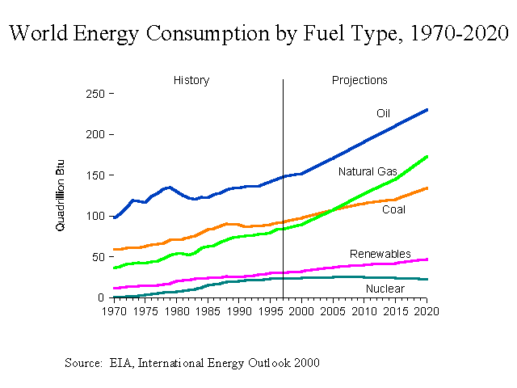

Slide 4
Energy Resources
Nonrenewable
Fossil fuels
Nuclear
Renewable Energy
Solar energy
Wind
Hydropower
Biomass
Geothermal

Slide 5
Fossil fuel
Fossil fuel is a general term for buried combustible geologic deposits of organic materials, formed from decayed plants and animals that have been converted to crude oil, coal, natural gas, or heavy oils by exposure to heat and pressure in the earth's crust over hundreds of millions of years.
Coal, Oil and Gas are called "fossil fuels” because they are natural combustible substances formed originally from dead plants and animals.

Slide 6
World Fuel Resources
Petroleum or Oil
Natural Gas
Coal
Power reserves
130 billion tonnes
158 billion cubic metres
950 billion tonnes
Total used in 1990
2.2 billion tonnes
1.5 billion cubic metres
2.2 billion tonnes
From the above table, the present world's estimated oil reserves may be used up in the next 100 years.

Slide 7
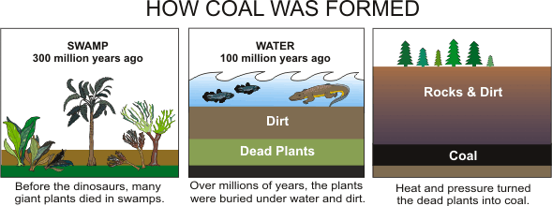
Coal
Coal is the plants, that grew in swampy areas about 300 million years ago, died to form layers of decaying material.
Heat, pressure and the action of bacteria changed the decaying plants into coal.

Slide 8
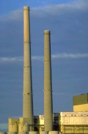
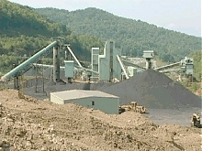
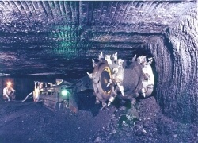
How is coal used?
Today, about 70% of the total coal mined is burned in power station.
Coal fueled the industrial revolution in the 18th and 19th century.
Coal Education (http://www.coaleducation.org/)

Slide 9
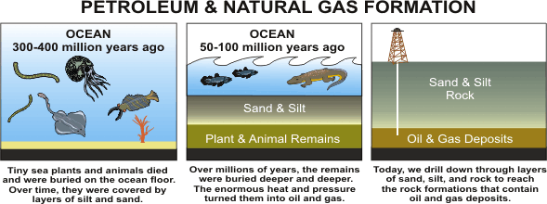
Petroleum
Petroleum was formed from small sea animals that lived millions of years ago. After they died, heat, pressure, and the action of bacteria changed the remains into oil. The oil formed was then trapped as small drops inside the pores of rocks.
Petroleum (http://www.petroleum.co.uk/)

Slide 10
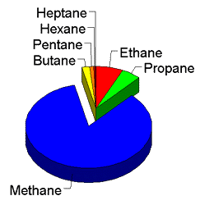
Natural Gas
Natural gas is found together with oil and sometimes with coal.
The gas consists mainly of methane CH₄.

Slide 11
Coal Is a Plentiful But Dirty Fuel
Used in electricity production
World’s most abundant fossil fuel
U.S. reserves should last about 250 years
Sulfur and particulate pollutants
Mercury and radioactive pollutants
Heavy carbon dioxide emissions
Pollution control and environmental costs
China major builder of coal based power plants

Slide 12
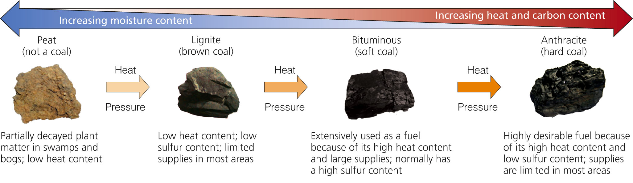

Slide 13
Clean Coal Campaign
EPA: in 2009 called for classifying coal ash as hazardous waste
  BUT Opposed by the coal companies
Coal industry:
  Rich and powerful
  Fought against labeling carbon dioxide a greenhouse gas

Slide 14
Clean Coal Campaign
Not all coal impurities can be removed. We can’t remove all the impurities from coal. It still gives more emissions than wind or solar power.
It is expensive. The manufacture and burning of clean coal costs quite a bit of money, making renewable energy sources more cost-effective.
It may not even happen. There are too many faults with the technology right now, and incorrect implementation will damage our environment because of the possible leaks and emissions it can cause!
Clean coal is a bad choice due to better alternatives already available, like wind, solar and hydroelectric.

Slide 15
Advantages and Disadvantages of Fossil Fuels

Slide 16
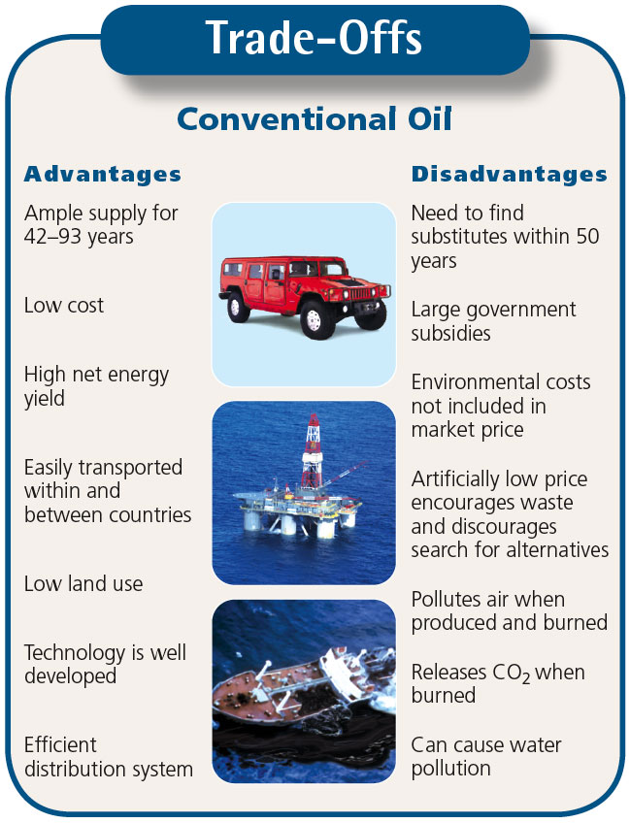

Slide 17
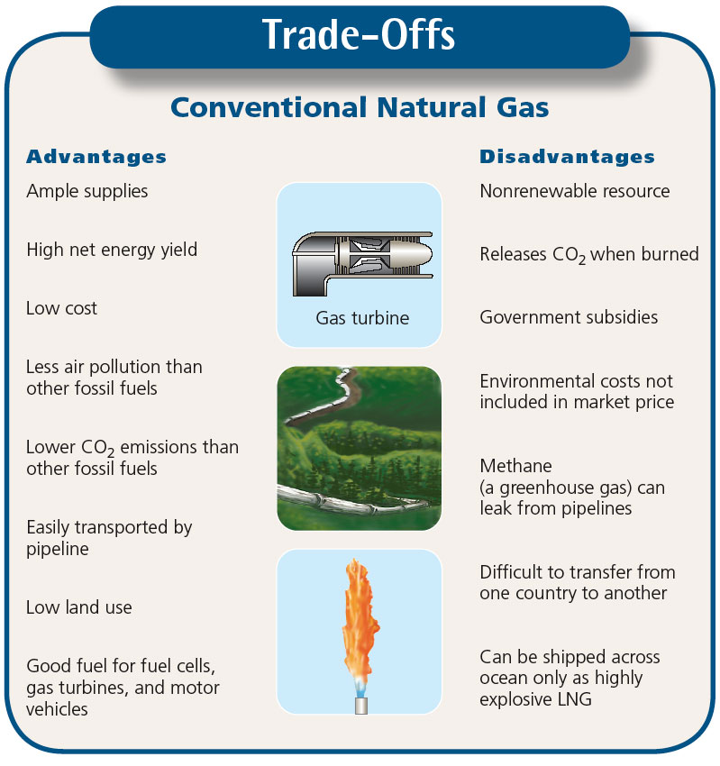

Slide 18
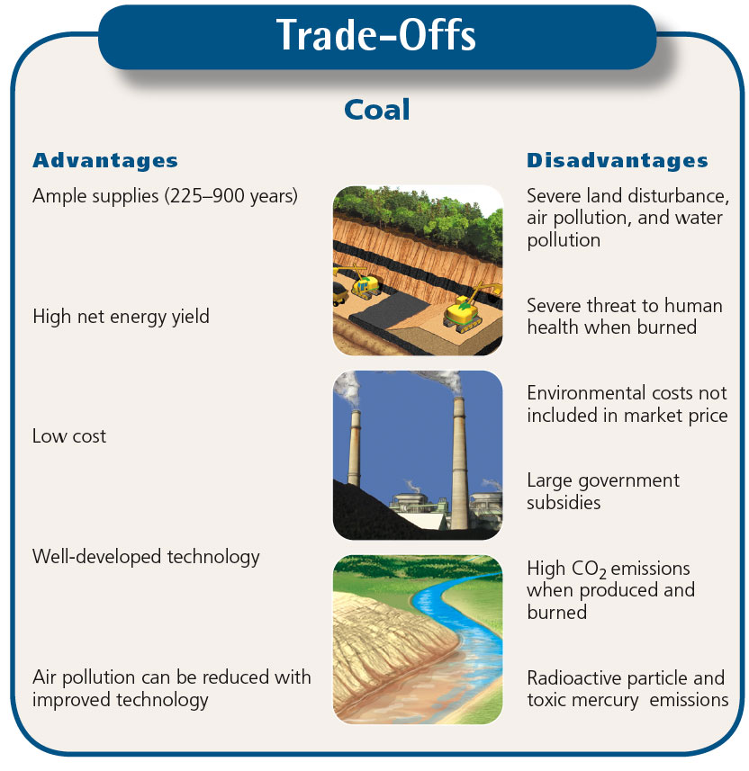

Slide 19
Nuclear Energy
Nuclear power is generated using Uranium, which is a metal mined in various parts of the world.
Nuclear power produces around 11% of the world's energy needs, and produces huge amounts of energy from small amounts of fuel with less pollution.
The nuclear power fuel cycle has a low environmental impact and a very low accident risk, but its use has been limited because of:
  high costs, a low net energy yield, long-lived radioactive wastes, vulnerability to sabotage, and the potential for spreading nuclear weapons.

Slide 20
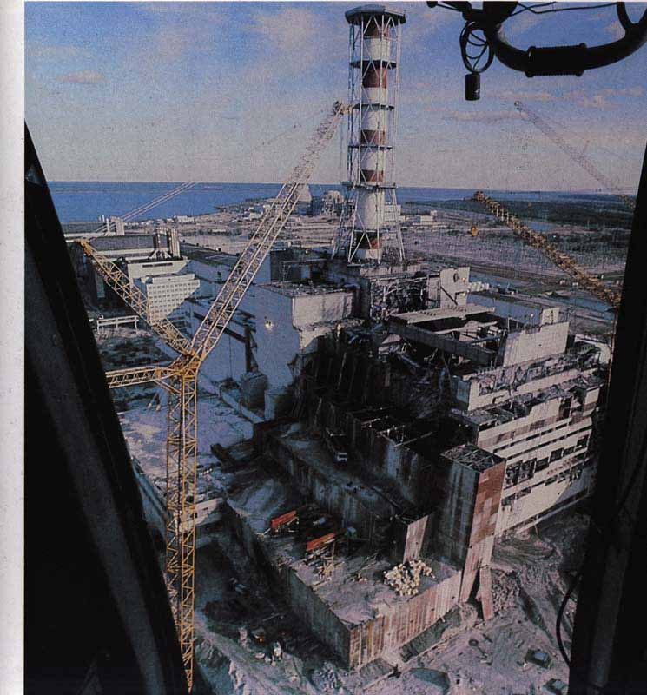


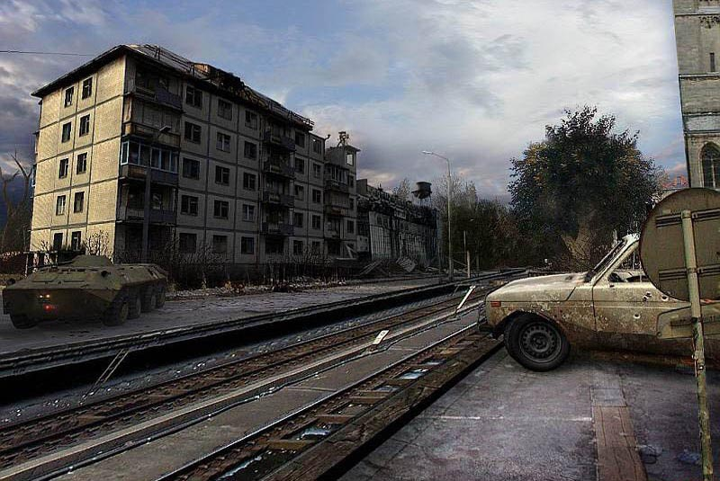
LEGACY OF CHERNOBYL
jburger.blogspot.com/
http://people.moreheadstate.edu/students/alsimp01/images/chernobyl.jpg
www.ebaumsworld.com/pictures/view/326426/

Slide 21
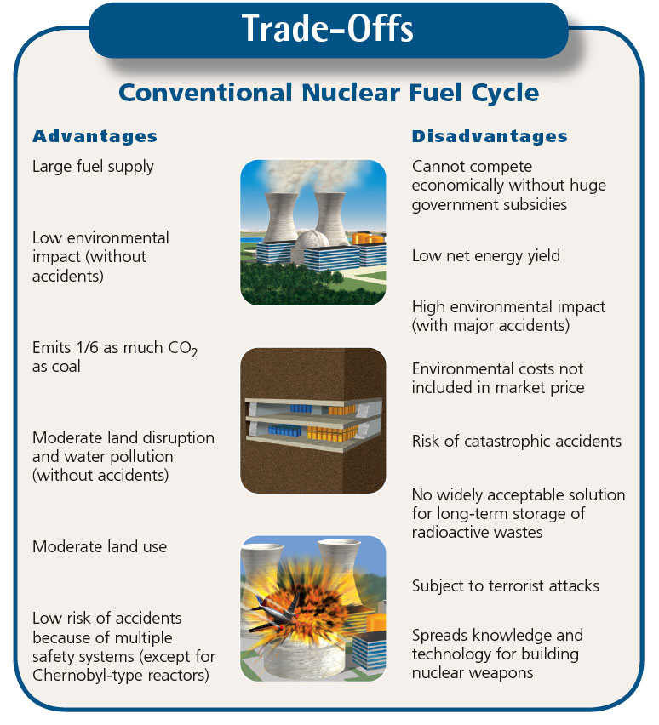

Slide 22
Renewable Energy
Sustainability mostly depends on solar energy
Direct form: from the sun
Indirect forms
  Wind
  Moving water
  Biomass
  Geothermal

Slide 23
Benefits of Shifting to Renewable Energy Resources
More decentralized, less vulnerable
Improve national security
Reduce air pollution
Create jobs
Save money
Renewable energy is handicapped by
  Unbalanced, intermittent subsidies
  Inaccurate pricing

Slide 24
Solar Energy for High-Temperature Heat and Electricity
Solar thermal systems
Solar thermal plant
Solar cookers
Photovoltaic (solar) cells

Slide 25
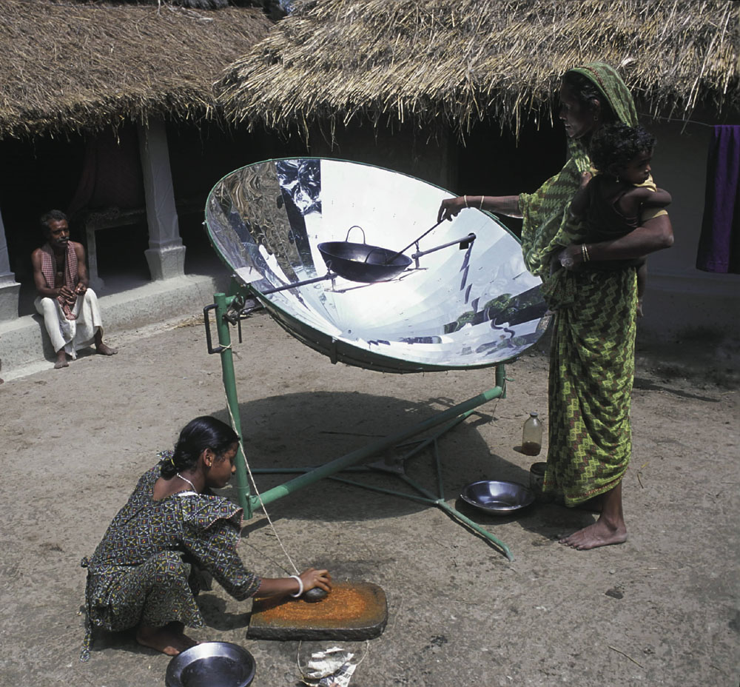

Slide 26
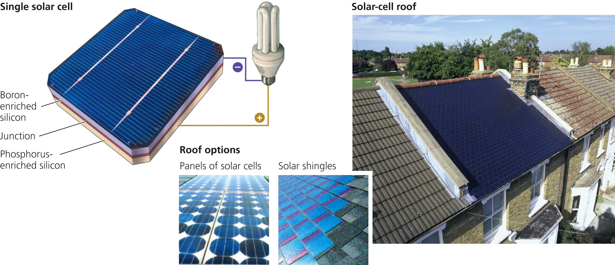
Photovoltaic (PV) or solar cells can provide electricity for a house or building using solar cell roof shingles, as shown in this house in Richmond Surrey, England. Solar-cell roof systems that look like a metal roof are also available. In addition, new thin-film solar cells can be applied to windows and outside walls.

Slide 27
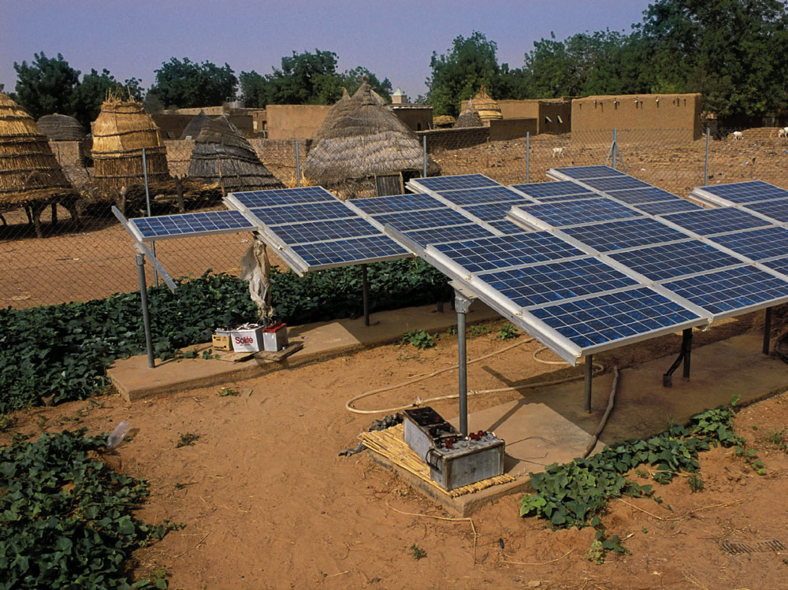

Slide 28
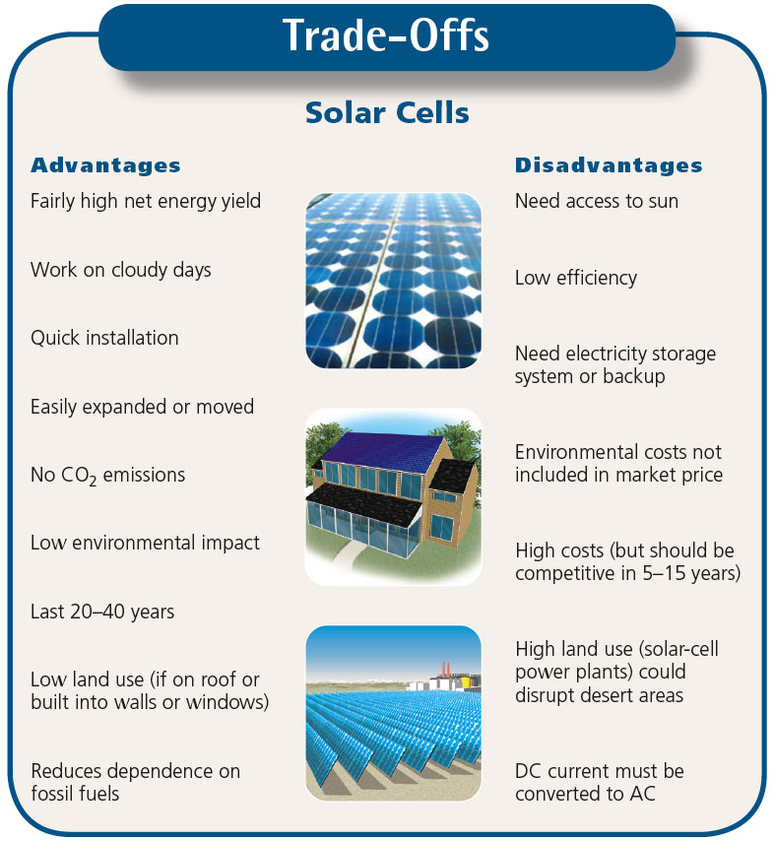

Slide 29
Hydropower
We have used running water as an energy source for thousands of years, mainly to grind corn.
The first use of water to generate electricity was in 1882 on the Fox river, in the USA, which produced enough power to light two paper mills and a house.
Nowadays there are many hydro-electric power stations, providing around 20% of the world's electricity. The name comes from "hydro", the Greek word for water.

Slide 30
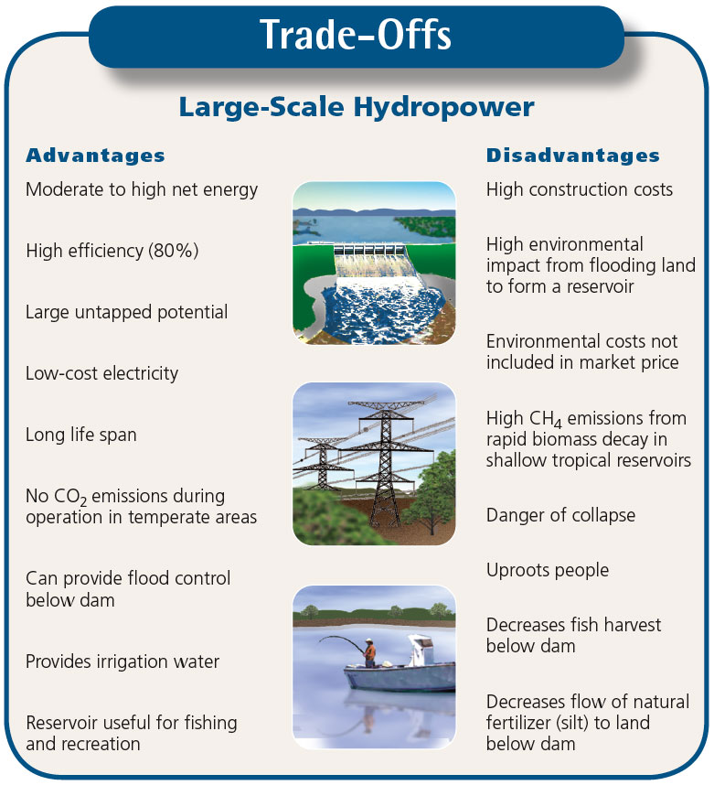

Slide 31
Producing Electricity from Wind
Indirect form of solar energy
World’s second fastest-growing source of energy
Vast potential
  Land
  Offshore

Slide 32
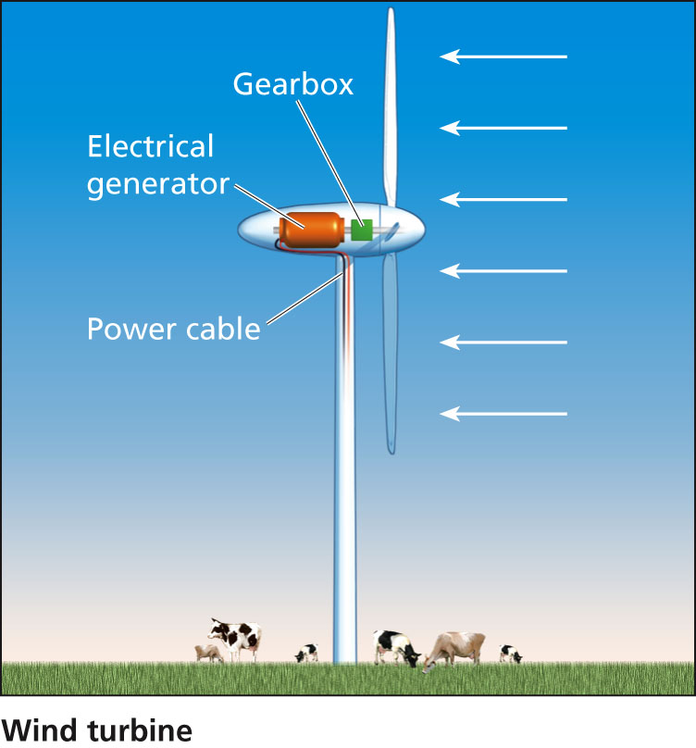

Slide 33


Slide 34


Slide 35
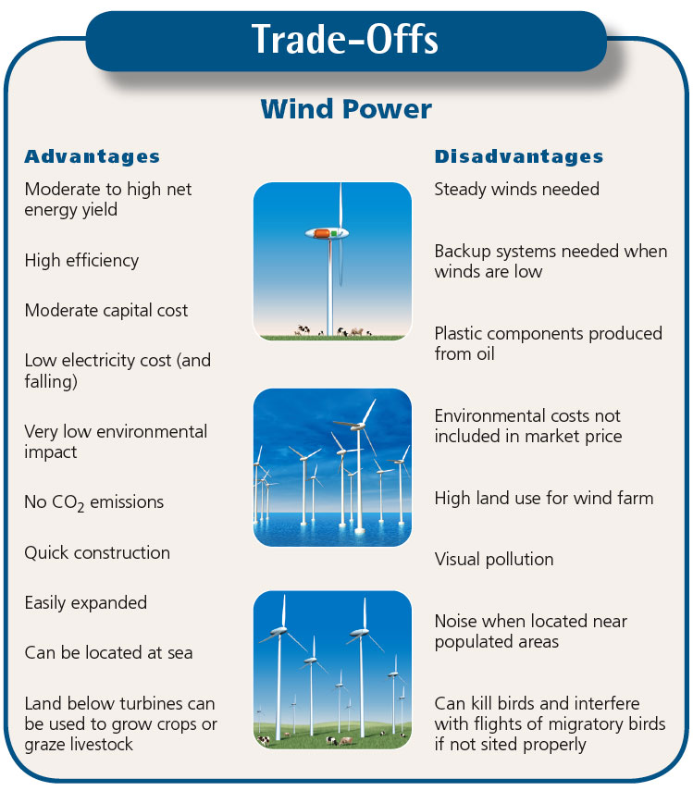

Slide 36
Geothermal
The centre of the Earth is around 6000 degress Celsius - hot enough to melt rock. Even a few kilometres down, the temperature can be over 250 degrees Celsius.
In general, the temperature rises one degree Celsius for every 36 metres you go down.
Geothermal energy has been used for thousands of years in some countries for cooking and heating.
The name "geothermal" comes from two Greek words: "geo" means "Earth" and "thermal" means "heat".

Slide 37
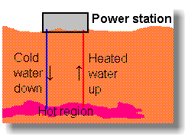
Geothermal…..
Hot rocks underground heat water to produce steam.
We drill holes down to the hot region, steam comes up, is purified and used to drive turbines, which drive electric generators.

Slide 38
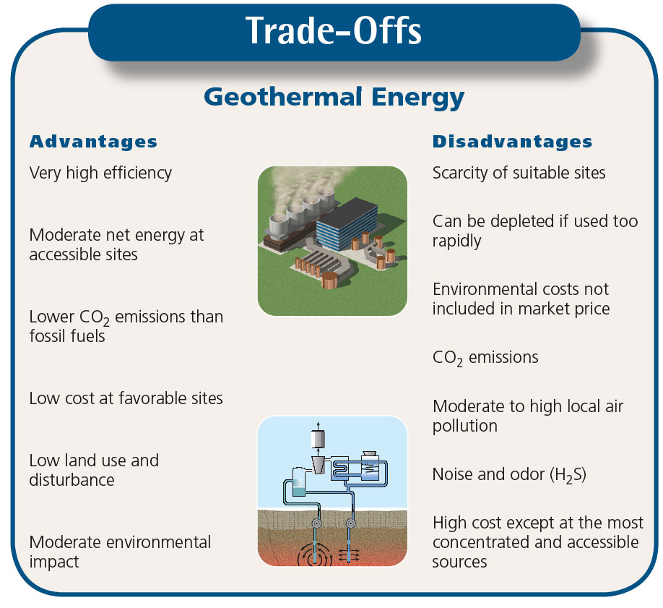

Slide 39
Why Is Energy Efficiency an Important Measure?
The United States could save as much as 43% of all the energy it uses by improving the energy efficiency of industrial operations, motor vehicles, and buildings.

Slide 40
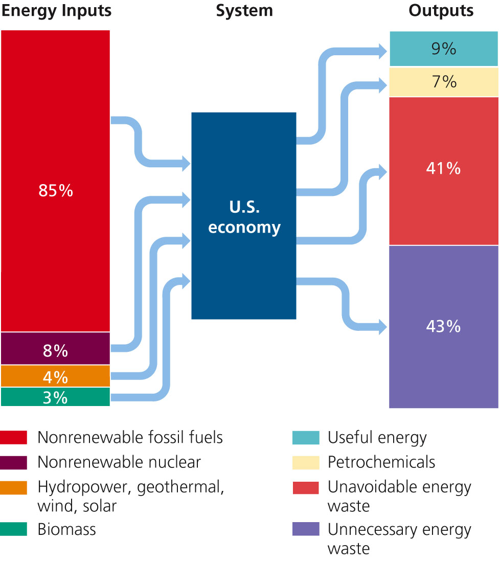

Slide 41
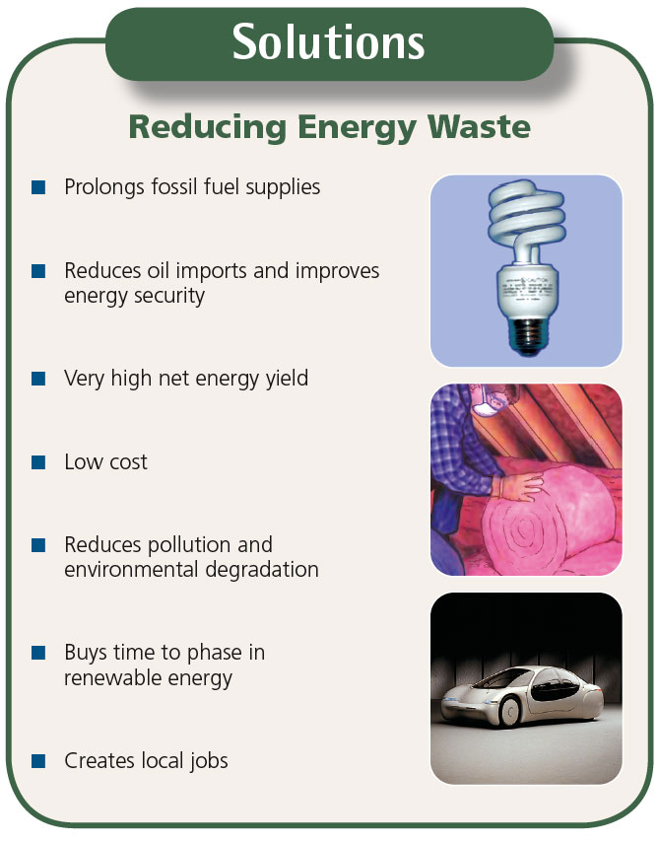

Slide 42
Why Are We Still Wasting So
Much Energy?
Energy costs relatively little
Lack of government support and economic incentives
Inadequate building codes
Inadequate appliance standards
Lack of information about saving energy

Slide 43
How Can We Make the Transition to a More Sustainable Energy Future?
We can make a transition to a more sustainable energy future by greatly improving energy efficiency:
  using a mix of renewable energy resources,
  Solar Net Metering Systems, and
  Including environmental costs of energy resources in their market prices.

Slide 44
According to the US Energy Information Administration the estimated 15TW total energy consumption of 2004:
Fuel type | Power in TW
Oil | 5.6
Gas | 3.5
Coal | 3.8
Hydroelectric | 0.9
Nuclear | 0.9
Geothermal, wind, solar, wood | 0.13
Total | 15

Slide 45
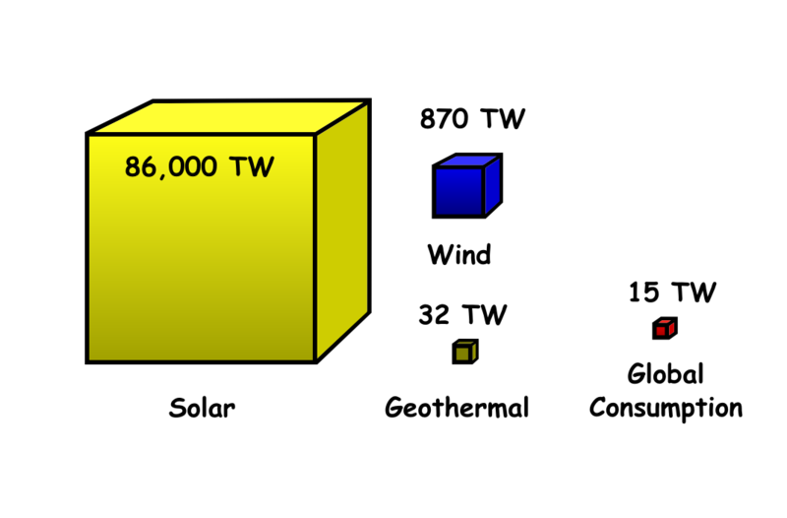
Available renewable energy. The volume of the cubes represent the amount of available geothermal, wind and solar energy in TW, although only a small portion is recoverable. The small red cube shows the proportional global energy consumption.

Slide 46
